Slide 1
Neural Network LMs
Read Chapter 7 in Jurafsky and Martin
Read Chapter 4 and Chapter 9 from Yoav Goldber’s book Neural Networks Methods for NLP
(It’s free to download from Penn’s campus!)

Slide 2
Recap: Logistic Regression
Logistic regression solves this task by learning, from a training set, a vector of weights and a bias term.
We can also write this as a dot product:
Notes:
The weight wi represents how important that input feature is to the classification decision, and can be positive (meaning the feature is associated with the class) or negative (meaning the feature is not associated with the class). Thus we might expect in a sentiment task the word awesome to have a high positive weight, and abysmal to have a very negative weight. The bias term, also called the intercept, is another real number that’s added to the weighted inputs.
But note that nothing forces z to be a legal probability, that is, to lie between 0 and 1. In fact, since weights are real-valued, the output might even be negative; z ranges from −∞ to ∞.

Slide 3
Recap: Sigmoid function
Notes:
But note that nothing forces z to be a legal probability, that is, to lie between 0 and 1. In fact, since weights are real-valued, the output might even be negative; z ranges from −∞ to ∞.
To create a probability, we’ll pass z through the sigmoid function, σ(z). The sigmoid function (named because it looks like an s) is also called the logistic func- tion, and gives logistic regression its name.

Slide 4
Recap: Probabilities

Slide 5

Recap: Loss functions
We need to determine for some observation x how close the classifier output ($\hat{y}$= σ (w · x + b)) is to the correct output y, which is 0 or 1.
$L\left(\hat{y}, y\right)=$how much $\hat{y}$ differs from the true y
Notes:
It turns out that this MSE loss, which is very useful for some algorithms like linear regression, becomes harder to optimize (technically, non-convex), when it’s applied to probabilistic classification.

Slide 6
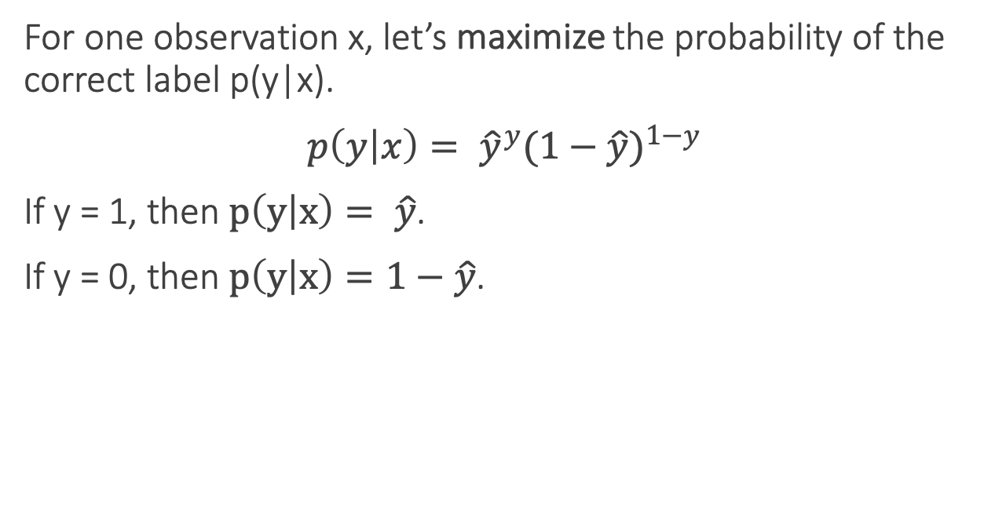
Recap: Loss functions
For one observation x, let’s maximize the probability of the correct label p(y|x).
$p\left(y | x\right)= {\hat{y}}^{y}{(1−\hat{y})}^{1−y}$
If y = 1, then $p\left(y | x\right)= \hat{y}$.
If y = 0, then $p\left(y | x\right)=1−\hat{y}$.
Notes:
It turns out that this MSE loss, which is very useful for some algorithms like linear regression, becomes harder to optimize (technically, non-convex), when it’s applied to probabilistic classification.

Slide 7
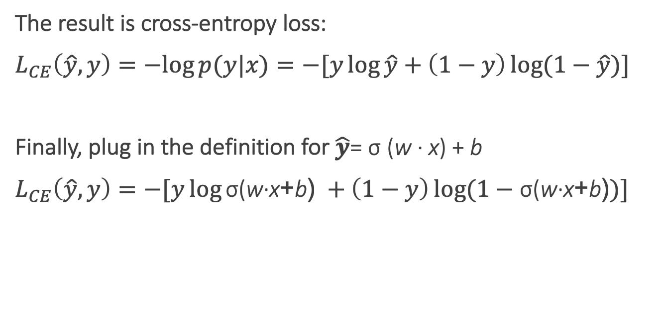
Recap: Cross-entropy loss
The result is cross-entropy loss:
$L_{CE}\left(\hat{y}, y\right)=−log{p(y|x)}=−[y\log{\hat{y}}+\left(1−y\right)\log{(1−\hat{y})]}$
Finally, plug in the definition for $\hat{y}$= σ (w · x) + b
$L_{CE}\left(\hat{y}, y\right)=−[y\log{\text{σ}\text{(}\text{w}\text{·}\text{x}\text{+}\text{b}\text{)} }+\left(1−y\right)\log{(1−\text{σ}\text{(}\text{w}\text{·}\text{x}\text{+}\text{b}\text{)})]}$
Notes:
It turns out that this MSE loss, which is very useful for some algorithms like linear regression, becomes harder to optimize (technically, non-convex), when it’s applied to probabilistic classification.
Information theoryEntropy
Differential entropy
Conditional entropy
Joint entropy
Mutual information
Conditional mutual information
Relative entropy
Entropy rate
Asymptotic equipartition property
Rate–distortion theory
Shannon's source coding theorem
Channel capacity
Noisy-channel coding theorem
Shannon–Hartley theorem
v
In information theory, the cross entropy between two probability distributions p and q over the same underlying set of events measures the average number of bits needed to identify an event drawn from the set, if a coding scheme is used that is optimized for an "artificial" probability distribution q, rather than the "true" distribution p.

Slide 8
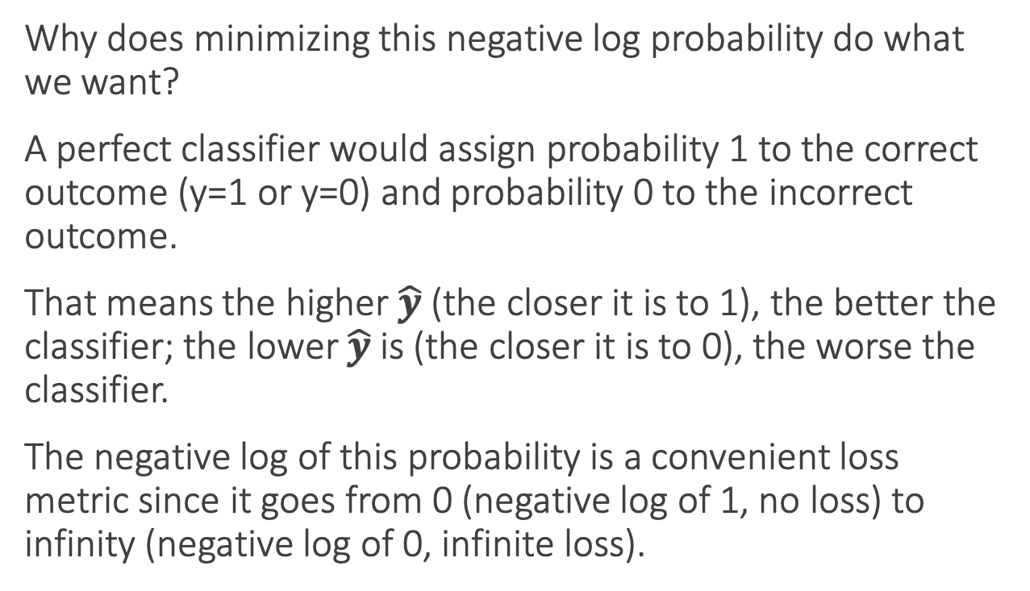
Recap: Cross-entropy loss
Why does minimizing this negative log probability do what we want?
A perfect classifier would assign probability 1 to the correct outcome (y=1 or y=0) and probability 0 to the incorrect outcome.
That means the higher $\hat{y}$ (the closer it is to 1), the better the classifier; the lower $\hat{y}$ is (the closer it is to 0), the worse the classifier.
The negative log of this probability is a convenient loss metric since it goes from 0 (negative log of 1, no loss) to infinity (negative log of 0, infinite loss).
Notes:
This loss function also insures that as probability of the correct answer is maximized, the probability of the incorrect answer is minimized; since the two sum to one, any increase in the probability of the correct answer is coming at the expense of the incorrect answer.

Slide 9
Finding good parameters
We use gradient descent to find good settings for our weights and bias by minimizing the loss function.
Gradient descent is a method that finds a minimum of a function by figuring out in which direction (in the space of the parameters θ) the function’s slope is rising the most steeply, and moving in the opposite direction.
Notes:
Our goal with gradient descent is to find the optimal weights: minimize the loss function we’ve defined for the model. In Eq. 5.16 below, we’ll explicitly represent the fact that the loss function L is parameterized by the weights, which we’ll refer to in machine learning in general as θ (in the case of logistic regression θ = w, b)

Slide 10
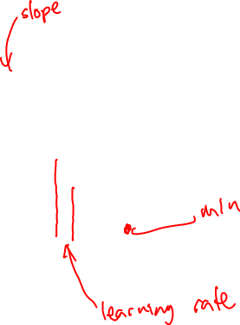
Iteratively find minimum
Notes:
The gradient descent algorithm answers this question by finding the gradient of the loss function at the current point and moving in the opposite direction. The gradient of a function of many variables is a vector pointing in the direction the greatest increase in a function. The gradient is a multi-variable generalization of the slope, so for a function of one variable like the one in Fig. 5.3, we can informally think of the gradient as the slope. The dotted line in Fig. 5.3 shows the slope of this hypothetical loss function at point w = w1. You can see that the slope of this dotted line is negative. Thus to find the minimum, gradient descent tells us to go in the opposite direction: moving w in a positive direction.
The first step in iteratively finding the minimum of this loss function, by moving w in the reverse direction from the slope of the function. Since the slope is negative, we need to move w in a positive direction, to the right. Here superscripts are used for learning steps, so w1 means the initial value of w (which is 0), w2 at the second step, and so on.

Slide 11

Stochastic gradient descent algorithm
Notes:
Stochastic gradient descent is an online algorithm that minimizes the loss function by computing its gradient after each training example, and nudging θ in the right direction (the opposite direction of the gradient).
Stochastic gradient descent is called stochastic because it chooses a single ran- dom example at a time, moving the weights so as to improve performance on that single example. That can result in very choppy movements, so it’s also common to do minibatch gradient descent, which computes the gradient over batches of train- ing instances rather than a single instance.
The learning rate η is a parameter that must be adjusted. If it’s too high, the learner will take steps that are too large, overshooting the minimum of the loss func- tion. If it’s too low, the learner will take steps that are too small, and take too long to get to the minimum. It is most common to begin the learning rate at a higher value, and then slowly decrease it, so that it is a function of the iteration k of training; you will sometimes see the notation ηk to mean the value of the learning rate at iteration k.

Slide 12
Neural Networks: A brain-inspired metaphor

Slide 13
A single neuron
Notes:
As the name suggests, neural networks were inspired by the brain’s computation mechanism, which consists of computation units called neurons. While the connections between artificial neural networks and the brain are in fact rather slim, we repeat the metaphor here for complete- ness. In the metaphor, a neuron is a computational unit that has scalar inputs and outputs. Each input has an associated weight. e neuron multiplies each input by its weight, and then sums1 them, applies a nonlinear function to the result, and passes it to its output. Figure 4.1 shows such a neuron.

Slide 14
Neural networks
Notes:
The neurons are connected to each other, forming a network: the output of a neuron may feed into the inputs of one or more neurons. Such networks were shown to be very capable computational devices. If the weights are set correctly, a neural network with enough neurons and a nonlinear activation function can approximate a very wide range of mathematical functions (we will be more precise about this later).
A typical feed-forward neural network may be drawn as shown. Each circle is a neuron, with incoming arrows being the neuron’s inputs and outgoing arrows being the neuron’s outputs. Each arrow carries a weight, reflecting its importance (not shown). Neurons are arranged in layers, reflecting the flow of information. The bottom layer has no incoming arrows, and is
the input to the network. the top-most layer has no outgoing arrows, and is the output of the network. The other layers are considered “hidden.” thee sigmoid shape inside the neurons in the middle layers represent a nonlinear function (i.e., the logistic function) that is applied to the neuron’s value before passing it to the output. In the figure, each neuron is connected to all of the neurons in the next layer—this is called a fully connected layer or an affine layer.

Slide 15
Mathematical Notation
The simplest neural network is called a perceptron. It is simply a linear model:
where W is the weight matrix and b is a bias term.
Notes:
Image from http://news.mit.edu/2017/new-tool-offers-snapshots-neuron-activity-0626

Slide 16
Mathematical Notation
To go beyond linear function, we introduce a non-linear hidden layer. The result is called a Multi-Layer Perceptron with one hidden layer.
Here W¹ and b¹ are a matrix and a bias for the first linear transformation of the input x,
g is a nonlinear function (also an activation function),
W² and b² are the matrix and bias term for a second linear transform.
Notes:
Image from http://news.mit.edu/2017/new-tool-offers-snapshots-neuron-activity-0626

Slide 17
Mathematical Notation
We can add additional linear transformations and nonlinearities, resulting with a MLP with two hidden layers:
Same equation, but written with intermediary variables:
Notes:
Thee vector resulting from each linear transform is referred to as a layer. The outer-most linear transform results in the output layer and the other linear transforms result in hidden layers. Each hidden layer is followed by a nonlinear activation. In some cases, such as in the last layer of our example, the bias vectors are forced to 0 (“dropped”).
Layers resulting from linear transformations are often referred to as fully connected, or affine. Other types of architectures exist. In particular, image recognition problems benefit from convolutional and pooling layers. Such layers have uses also in language processing.
Networks with several hidden layers are said to be deep networks, hence the name deep learning. 

Slide 18
Dimensions of the layers
A neural network can be described the the dimensions of its layers and of its input.
d_{in} is the number of dimensions of the input vector
d_{out} is the number of dimensions of the output vector
A fully connected layer l(x) = xW + b with input size d_{in} and and output size d_{out} will have the following dimensions:
the dimensions of x are 1 x d_{in}
the dimensions of W are d_{in} x d_{out}
the dimensions of b are 1 x d_{out}
Notes:
When describing a neural network, one should specify the dimensions of the layers and the input. A layer will expect a din dimensional vector as its input, and transform it into a dout dimensional vector. e dimensionality of the layer is taken to be the dimensionality of its output. For a fully connected layer l.x/ D xW C b with input dimensionality din and output dimensionality dout,thedimensionsofxis1􏰎din,ofW isdin 􏰎dout andofbis1􏰎dout.

Slide 19
Dimensions of the output layer
d_{out} = 1 means the neural networks output is a scalar. Such networks can be used for
Regression or scoring
Binary classification
d_{out} = k > 1 can be used for k-class classification.
Associate each dimension with a class, and look for the dimension with maximal value.
If the output vector entries are positive and sum to one, the output can be interpreted as a distribution over class assignments.
The softmax forces the values in an output layer to be positive and sum to 1, making them interpretable as a probability distribution.
Notes:
d_{out} = 1: Such networks can be used for regression (or scoring) by considering the value of the output, or for binary classification by consulting the sign of the output.

Slide 20
Representation Power
A Multi-Layer Perceptron with one hidden layer is a “universal approximator”.
It can approximate a family of functions that includes all continuous functions on a closed and bounded subset of R^{n}
It can approximate any function mapping from any finite dimensional discrete space to another.
So why use multiple layers?
Notes:
This may suggest there is no reason to go beyond MLP1 to more complex architectures. However, the theoretical result does not discuss the learnability of the neural network (it states that a represen- tation exists, but does not say how easy or hard it is to set the parameters based on training data and a specific learning algorithm). It also does not guarantee that a training algorithm will find the correct function generating our training data. Finally, it does not state how large the hidden layer should be. Indeed, Telgarsky [2016] show that there exist neural networks with many layers of bounded size that cannot be approximated by networks with fewer layers unless these layers are exponentially large.

Slide 21
Common Nonlinearities
Notes:
The nonlinearity g can take many forms. There is currently no good theory as to which nonlinearity to apply in which conditions and choosing the correct nonlinearity for a given task is for the most part an empirical question. The common nonlinearities from the literature are the sigmoid, tanh, hard tanh and the rectified linear unit (ReLU).

Slide 22
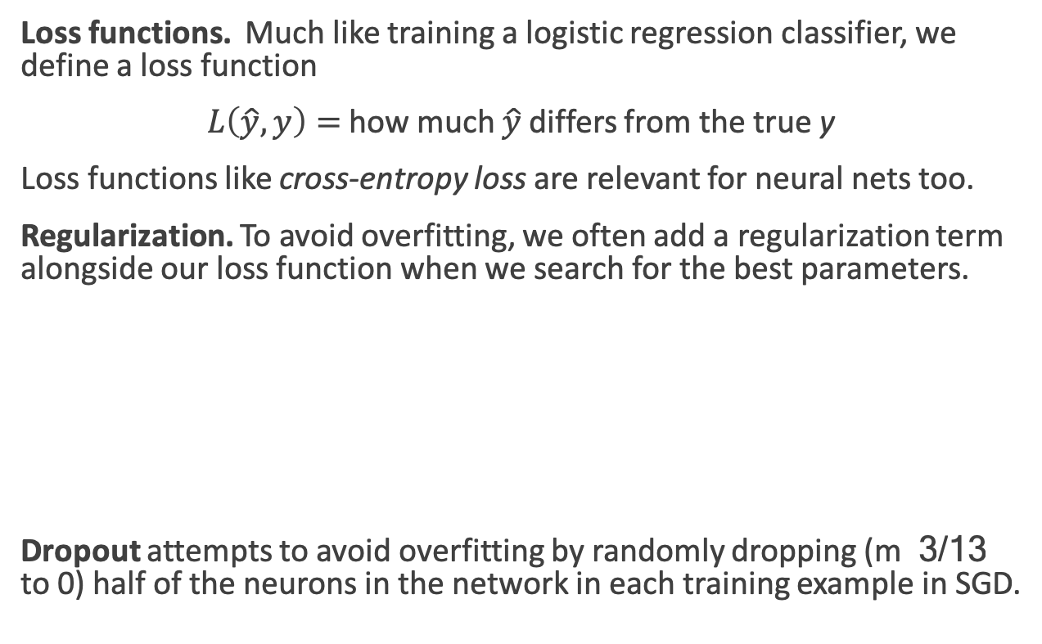
Training concerns
Loss functions. Much like training a logistic regression classifier, we define a loss function
$L\left(\hat{y}, y\right)=$how much $\hat{y}$ differs from the true y
Loss functions like cross-entropy loss are relevant for neural nets too.
Regularization. To avoid overfitting, we often add a regularization term alongside our loss function when we search for the best parameters.
Dropout attempts to avoid overfitting by randomly dropping (m 3/13 to 0) half of the neurons in the network in each training example in SGD.
Notes:
In practice, the regularizers R equate complexity with large weights, and work to keep the parameter values low. In particular, the regularizers R measure the norms of the parameter matrices, and drive the learner toward solutions with low norms. Common choices for R are the L2 norm, the L1 norm, and the elastic-net.
Another effective technique for preventing neural networks from overfitting the training data is dropout training [Hinton et al., 2012, Srivastava et al., 2014]. e dropout method is designed to prevent the network from learning to rely on specific weights. It works by randomly dropping (setting to 0) half of the neurons in the network (or in a specific layer) in each training example in the stochastic-gradient training. For example, consider the multi-layer perceptron with two hidden layers (MLP2):

Slide 23
Language Models
Estimate the probability of a sentence consisting of word sequence w_{1:n}
We need to estimate the probability of P(w_{i+1}|w_{k-i:i}) from a large corpus.

Slide 24
Limitations of LMs
The “curse of dimensionality”. If we want to model the full joint distribution of 10 consecutive words with a vocabulary V of size 100,000, there are potentially 100,000¹⁰ =10⁵⁰ -free parameters.
In n-gram LMs, we simplify this to predict the next word given a limited context. We construct conditional probabilities table for n given n-1.
Only those combinations of successive words that actually occur in our training corpus are recorded in the table.
Having observed black car and blue car does not influence our estimates of red car.
A lot of what we do is language modelling (smoothing, backoff, etc) is trying to deal with the unobserved entries.
Notes:
A fundamental problem that makes language modeling and other learning problems diffi- cult is the curse ofdimensionality. It is particularly obvious in the case when one wants to model the joint distribution between many discrete random variables (such as words in a sentence, or discrete attributes in a data-mining task). For example, if one wants to model the joint distribution of 10 consecutive words in a natural language with a vocabulary V of size 100,000, there are potentially 10000010 - 1 =1050 - 1 free parameters.

Slide 25
Neural LMs (Bengio et al 2003)
Associate each word in the vocabulary with a vector-representation, thereby creating a notion of similarity between words.
Express the joint probability function of a word sequence in terms of the word vectors for the words in that sequence.
Simultaneously learn the word vectors and the parameters of the function.
The word vectors are low-dimensional (d=30 to d=100) dense vectors, like we’ve seen before.
The probability function is expressed the product of conditional probabilities of the next word given the previous word, using a multi-layer neural network.

Slide 26
Neural LMs
The input to the neural network is a k-gram of words w_{1:k}.
The output is a probability distribution over the next word.
The k context words are treated as a word window. Each word is associated with an embedding vector:
The input vector x just concatenates v(w) for each of the k words:

Slide 27
Neural LMs
The input x is fed into a neural network with 1 or more hidden layers:
Notes:
V is a finite vocabulary, including the unique symbols U for unknown words, <s> for sentence initial padding, and </s> for end-of-sequence marking. e vocabulary size, jV j, ranges between 10,000–1,000,000 words, with the common sizes revolving around 70,000.

Slide 28
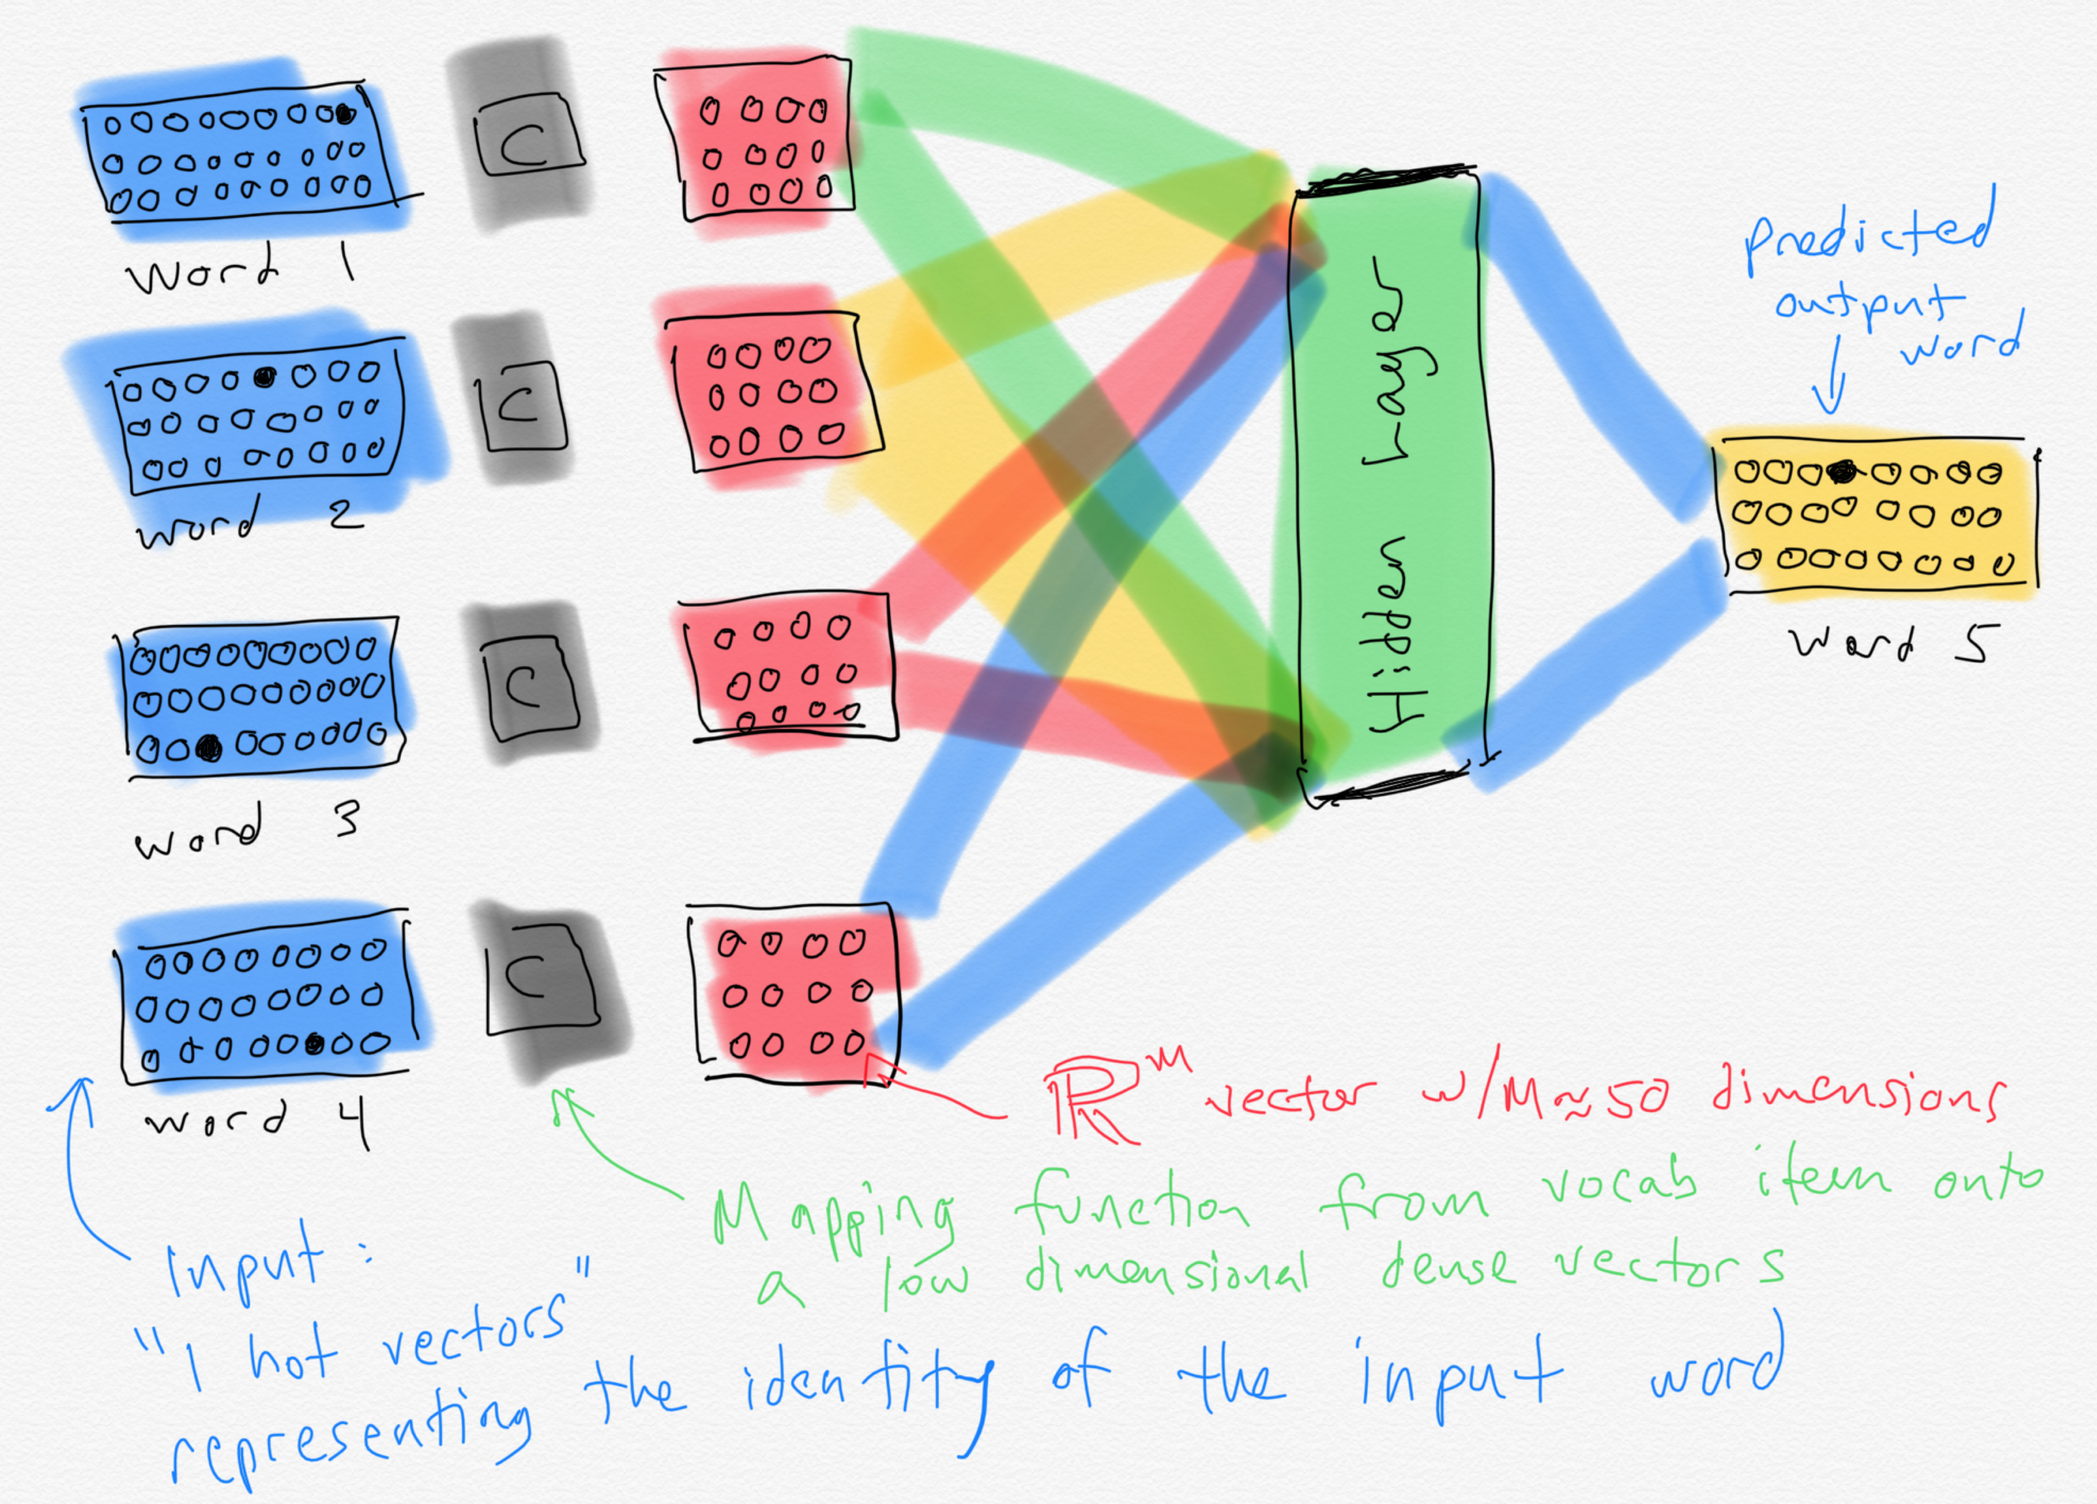

Slide 29
Training
The training examples are simply word kgrams from the corpus
The identities of the first k+1 words are used as features, and the last word is used as the target label for the classification.
Conceptually, the model is trained using cross-entropy loss.
Working with cross entropy loss works very well, but requires the use of a costly softmax operation which can be prohibitive for very large vocabularies, we we often use alternative loss functions or approximations.
Notes:
Large output spaces Working with neural probabilistic language models with large output spaces (i.e., efficiently computing the softmax over the vocabulary) can be prohibitive both at training time and at test time. Dealing with large output spaces efficiently is an active research question. Some of the existing solutions are as follows.
Hierarchical softmax [Morin and Bengio, 2005] allows to compute the probability of a single word in O.log jV j/ time rather than O.jV j/. is is achieved by structuring the softmax computation as tree traversal, and the probability of each word as the product of branch selection decisions. Assuming one is interested in the probability of a single word (rather than getting the distribution over all words) this approach provides clear benefits in both training and testing time. Self-normalizing aproaches, such as noise-contrastive estimation (NCE) [Mnih and Teh, 2012, Vaswani et al., 2013] or adding normalizing term to the training objective [Devlin et al., 2014]. e NCE approach improves training time performance by replacing the cross-entropy objective with a collection of binary classification problems, requiring the evaluation of the assigned scores for k random words rather than the entire vocabulary. It also improves test-time prediction by pushing the model toward producing “approximately normalized” exponentiated scores, making the model score for a word a good substitute for its probability. e normalization term approach of Devlin et al. [2014] similarly improves test time efficiency by adding a term to the training objective that encourages the exponentiated model scores to sum to one, making the explicit summation at test time unnecessary (the approach does not improve training time efficiency). Sampling Approaches approximate the training-time softmax over a smaller subset of the vocabu- lary [Jean et al., 2015].
A good review and comparison of these and other techniques for dealing with large output vocabularies is available in Chen et al. [2016].
An orthogonal line of work is attempting to sidestep the problem by working at the char- acters level rather than words level.

Slide 30
Advantages of NN LMs
Better results. They achieve better preplexity scores than SOTA n-gram LMs.
Larger N. NN LMs can scale to much larger orders of n. This is achievable because parameters are associated only with individual words, and not with n-grams.
They generalize across contexts. For example, by observing that the words blue, green, red, black, etc. appear in similar contexts, the model will be able to assign a reasonable score to the green car even though it never observed in training, because it did observe blue car and red car.
A by-product of training are word embeddings!
Notes:
Language models can be trained on raw text: for training a k-order language model one just needs to extract .k C 1/grams from running text, and treat the .k C 1/th word as the supervision signal. us, we can generate practically unlimited training data for them.

Slide 31
Language Modeling
Goal: Learn a function that returns the joint probability
Primary difficulty:
There are too many parameters to accurately estimate. This is sometimes called the “curse of dimensionality”
In n-gram-based models we fail to generalize to related words / word sequences that we have observed.

Slide 32
Curse of dimensionality / sparse statistics
Suppose we want a joint distribution over 10 words. Suppose we have a vocabulary of size 100,000.
100,000¹⁰ =10⁵⁰ parameters
This is too high to estimate from data.

Slide 33
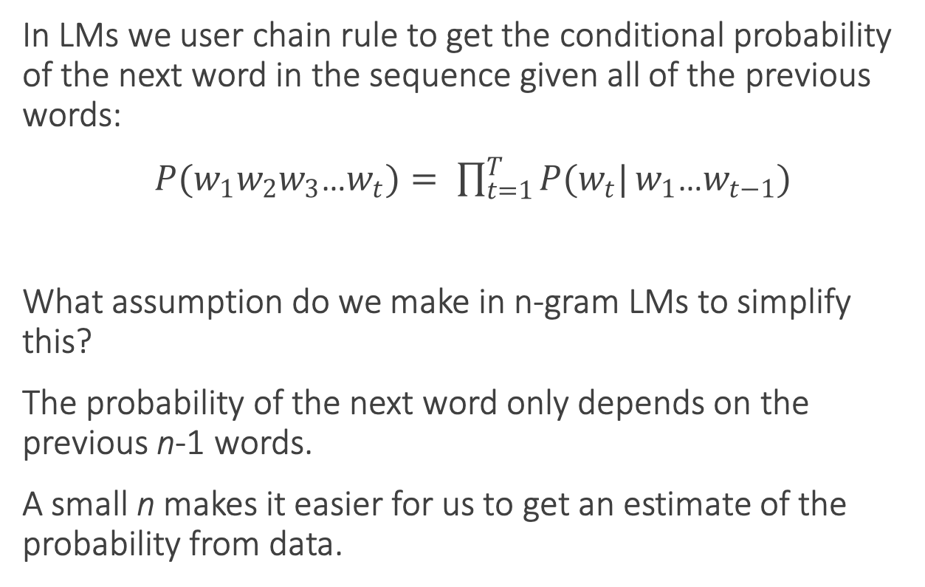
Chain rule
In LMs we user chain rule to get the conditional probability of the next word in the sequence given all of the previous words:
$P(w_{1}w_{2}w_{3}$…$w_{t})= \prod_{t=1}^{T}{P(w_{t}|}w_{1}$…$w_{t−1})$
What assumption do we make in n-gram LMs to simplify this?
The probability of the next word only depends on the previous n-1 words.
A small n makes it easier for us to get an estimate of the probability from data.

Slide 34
Probability tables
We construct tables to look up the probability of seeing a word given a history.
The tables only store observed sequences.
What happens when we have a new (unseen) combination of n words?
curse of | P(w_{t} | w_{t-n} … w_{t-1})
dimensionality
azure
knowledge
oak
Notes:
“Stupid” multinomial distributions == table lookup.

Slide 35
Unseen sequences
What happens when we have a new (unseen) combination of n words?
Back-off
Smoothing / interpolation
We are basically just stitching together short sequences of observed words.

Slide 36
Alternate idea
Let’s try generalizing.
Intuition: Take a sentence like
The cat is walking in the bedroom
And use it when we assign probabilities to similar sentences like
The dog is running around the room
Notes:
Draw vectors under the words.
Write out: sim(cat, dog)

Slide 37
A Neural Probabilistic LM
Bengio et al NIPS 2003
Use a vector space model where the words are vectors with real values ℝ^{m}. m=30, 60, 100. This gives a way to compute word similarity.
Define a function that returns a joint probability of words in a sequence based on a sequence of these vectors.
Simultaneously learn the word representations and the probability function from data.
Seeing one of the cat/dog sentences allows them to increase the probability for that sentence and its combinatorial # of “neighbor” sentences in vector space.

Slide 38
A Neural Probabilistic LM
Given:
A training set w₁ … w_{t} where w_{t} ∈V
Learn:
f(w₁ … w_{t}) = P(w_{t}|w₁ … w_{t-1})
Subject to giving a high probability to an unseen text/dev set (e.g. minimizing the perplexity)
Constraint:
Create a proper probability distribution (e.g. sums to 1) so that we can take the product of conditional probabilities to get the joint probability of a sentence

Slide 39
A Neural Probabilistic LM
Create a mapping function C from any word in V onto ℝ^{M}. Store this in a V-by-M matrix. Initialize it with singular value decomposition (SVD).
The neural architecture: a function g maps sequence of word vectors onto a probability distribution over the vocabulary V
g(C(w_{t-n}) … C(w_{t-1})) = P(w_{t}|w_{t-n} … w_{t-1})
Notes:
g is implemented with a feed forward or recurrent neural network, trained with stochastic gradient descent. Softmax is used in the output layer.

Slide 41
Word embeddings
When the ~50 dimensional vectors that result from training a neural LM are projected down to 2-dimensions, we see a lot of words that are intuitively similar to each other are close together.
Notes:
A by-product of training neural network-based language models are dense word embeddings, similar to word2vec.

Slide 42
Current state of the art neural LMs
ELMo
GPT
BERT
GPT-2
Notes:
ELMo: Embeddings from Language Models
GPT: Improving Language Understanding by Generative PreTraining
BERT: Bidirectional Encoder Representations from Transformers.

